Slide 1
Team Members: - Phadima Maredi
- Sinethemba Willie - Vatiswa Gebe
- Andile Lwanga - Lutho Makasi

Slide 2
What can we do about the major challenges facing South Africa From Technology Perspective?

Slide 3
Major Challenges: - Unemployment - Poverty - GBV, Rapes, Murders (CRIME)

Slide 4
What Can Be Done? - Create a Citizen Identifier System System Stores:
- DNA Profile
- Fingerprints
- Pictures
- Personal Details (ID Number,
Names, Address, ….)
What Can Be Done? - Create a Citizen Identifier System System Stores:
- DNA Profile
- Fingerprints
- Pictures
- Personal Details (ID Number,
Names, Address, ….)

Slide 5
Data Collection: - Parliament to implement a mandatory law which states that everyone must submit their Data
- HOME AFFAIRS on board. (ID Doc must expire after 5 years.)

Slide 6
Data Collection: - First Time ID Doc Makers, submit
Data first before making ID Doc
- Get people to go to South Africans
and collect the Data (Census)
- Failure to Submit data, you'll be
arrested and be taken forcefully

Slide 7
How Will It Tackle The Problems?

Slide 8
Unemployment

Slide 9
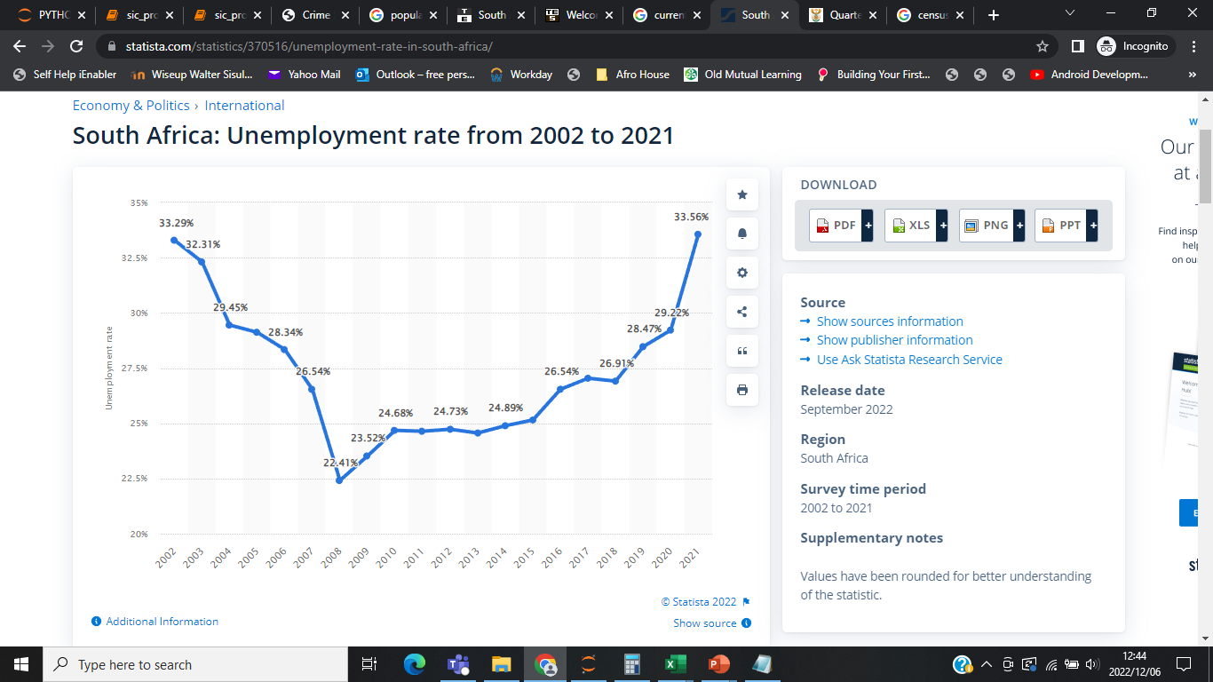

Slide 10
Professions Required: - Attorneys / Lawyers
- Forensics
- Doctors
- Scientists
- Engineers
- Database specialists
- Maintenance
- Data Capturers
- Laboratories

Slide 11
CRIME

Slide 12
- DNA OR Fingerprints from
Crime Scene can be used to
identify the perpetrator
- If don't find perpetrator, the
relatives will lead to the
perpetrator
- Image of a perpetrator

Slide 13
WE DO NOT WAIT FOR THEM TO COMMIT CRIME TO COLLECT THEIR DATA, WE GO TO THEM FIRST

Slide 14
Poverty

Slide 15
Getting People to their Families or relatives
Less Unemployment, Less Poverty

Slide 16
In Addition:

Slide 17
- Stress and Depression, Kills Brains Cells
(Find your other possible relatives)
- Save Future Scientists, Doctors, Engineers, etc….

Slide 18
- Lost Loved Ones (Khumbul'e Khaya)
- Accidents
- GBV | After Giving Birth | Department of Health

